Slide 1
PIZZA SALES ANALYSIS
USING SQL

Slide 2
PROJECT OVERVIEW:
This project applies SQL to analyze pizza sales data, providing valuable insights into customer preferences and sales performance. By answering key business questions, we aim to help optimize decision-making and drive growth, including:
The total number of orders and overall revenue
The most popular pizza types and sizes
Sales trends and patterns throughout the day
Core SQL Techniques Used:
Aggregation & Grouping to calculate totals and identify patterns
Joins to merge related data from multiple tables
Window Functions to analyze trends over time
Common Table Expressions (CTEs) for more efficient and readable queries
Objective: The goal is to leverage SQL to extract meaningful insights that will inform business strategies, enhance operational efficiency, and maximize profitability.

Slide 3
DATABASE INCLUDES:
PIZZAS | PIZZA_TYPE | ORDER_DETAILS | ORDERS
pizza_id | pizza_type_id | Order_details_id | Order_id
Pizza_type_id | name, | Order_id | date
size | Category | Pizza_id | time
price | ingredients | quantity

Slide 4
Basic: 1. Retrieve the total number of orders placed. 2. Calculate the total revenue generated from pizza sales. 3. Identify the highest-priced pizza. 4. Identify the most common pizza size ordered. 5. List the top 5 most ordered pizza types along with their quantities. Intermediate: 6. Join the necessary tables to find the total quantity of each pizza category ordered. 7. Determine the distribution of orders by hour of the day. 8. Join relevant tables to find the category-wise distribution of pizzas. 9. Group the orders by date and calculate the average number of pizzas ordered per day. 10. Determine the top 3 most ordered pizza types based on revenue. Advanced: 11. Calculate the percentage contribution of each pizza type to total revenue. 12. Analyze the cumulative revenue generated over time. 13. Determine the top 3 most ordered pizza types based on revenue for each pizza category.
QUESTIONS TO BE ANSWERED.

Slide 5
1.Retrieve the total number of orders placed.

Slide 6
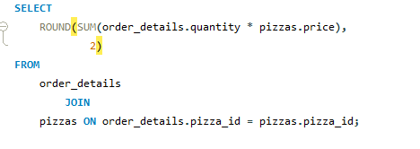
2.Calculate the total revenue generated from pizza sales.

Slide 7
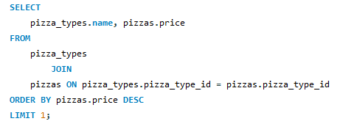
3. Identify the highest-priced pizza.

Slide 8
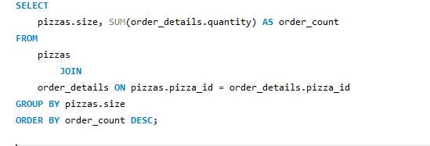
4. Identify the most common pizza size ordered.

Slide 9
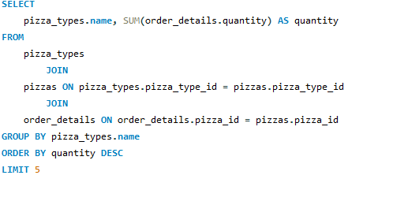
5. List the top 5 most ordered pizza types along with their quantities.

Slide 10
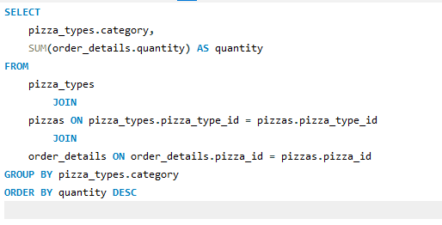
6. Join the necessary tables to find the total quantity of each pizza category ordered.

Slide 11
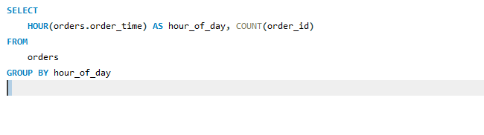
7. Determine the distribution of orders by hour of the day

Slide 12
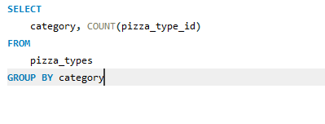
8. Join relevant tables to find the category-wise distribution of pizzas

Slide 13
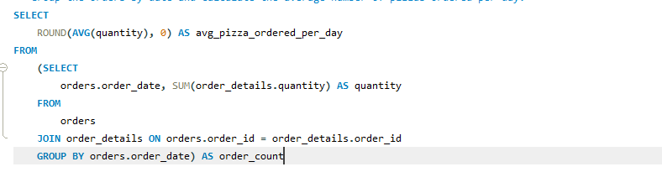
9.Group the orders by date and calculate the average number of pizzas ordered per day.

Slide 14
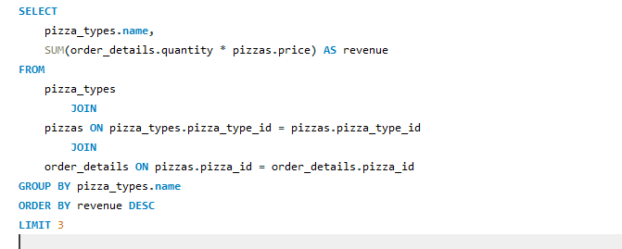
10. Determine the top 3 most ordered pizza types based on revenue.

Slide 15
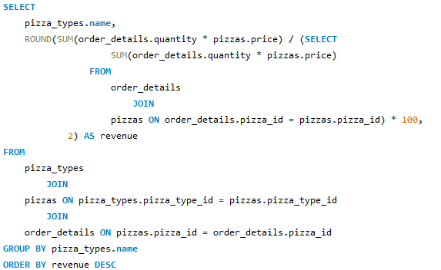
11. Calculate the percentage contribution of each pizza type to total revenue

Slide 16
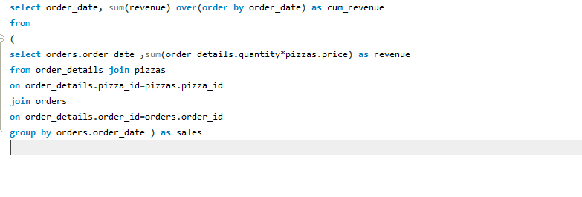
12.Analyze the cumulative revenue generated over time.

Slide 17
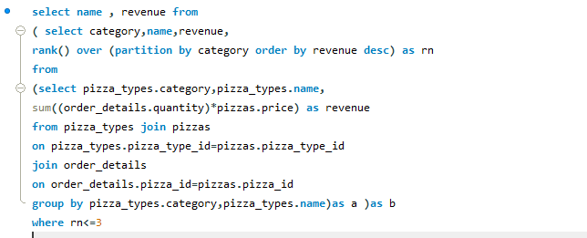
13.Determine the top 3 most ordered pizza types based on revenue for each pizza category.

Slide 18
THANK YOU!

